Slide 1
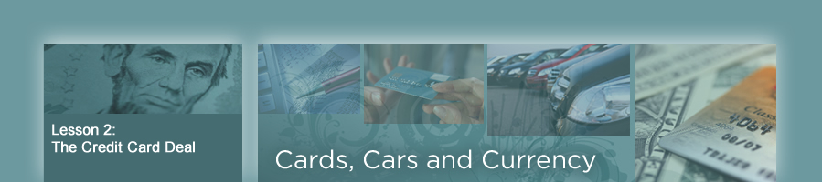
Credit is the ability of a consumer to obtain goods or services before payment of cash, based on an agreement to pay later.

Slide 2
Key Terms for Credit
Collateral: something pledged as repayment of a loan such as a house, car, or other asset (something you own worth money)
Unsecured Loan: a loan/credit that isn't backed by any collateral, meaning you don't need to pledge an asset like a car or house to get the loan.
Secured Loan: type of loan where the borrower pledges an asset as collateral to guarantee repayment
Interest is the price of using someone else's money
basically what you are charged to borrow it.

Slide 3
Credit Card: a small plastic card issued by a bank, business, etc., allowing the holder to purchase goods or services on credit.
Key Facts:
Represents an agreement between a lender and the cardholder.
They are Unsecured Loans – no collateral required
Called "easy access" credit - easy to acquire.
Receive a monthly statement from the credit card issuer that includes a list of purchases and payment information.
Charged Interest at higher rates than secured loans due to the risk of non-payment
Annual APR stands for Annual Percentage Rate. It's a yearly interest rate that reflects what you are charged to borrow money.

Slide 4
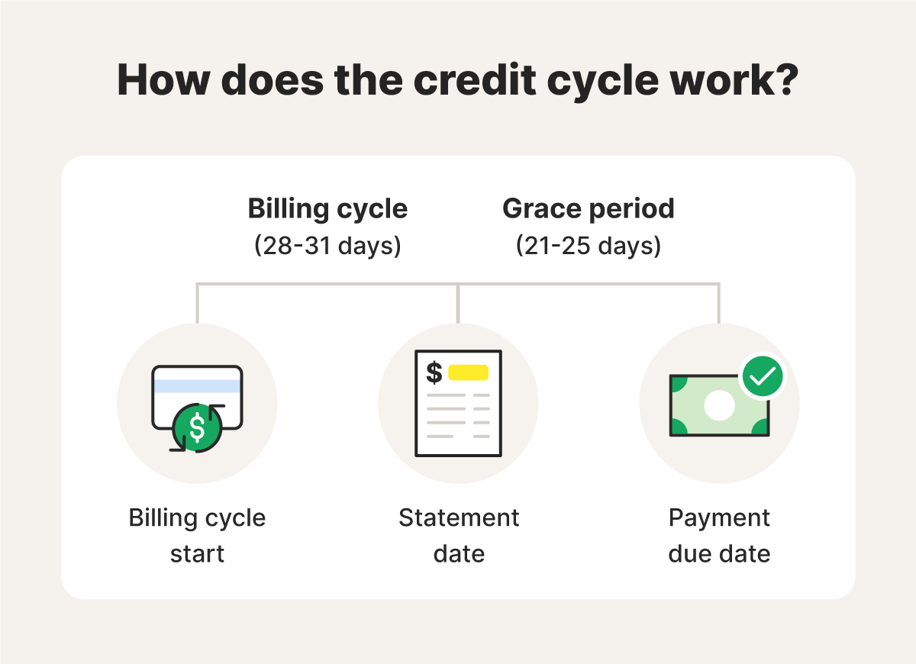
Grace Period of Credit Card: the time between the end of a billing cycle and the payment due date when you can pay your credit card balance in full without incurring interest charges on new purchases
Purchased New Shoes $100
Paid Shoes off – No Interest

Slide 5
Charged Interest on purchases after Grace Period Is over
Purchased New Shoes $100
Paid Shoes off –Interest at 14.99% APR

Slide 6
Did you know—
In 2024, credit card issuers imposed $14 billion in penalty fees on credit card holders--up more than 50 percent since 2003
There are more than 6,000 major credit card issuers?

Slide 7
Most Common Credit Card Fees
Purchase APR (Interest) – Charged on unpaid balances after the grace period.
Cash Advance APR – Higher interest rate for cash advances, often with no grace period.
Penalty APR – A higher interest rate triggered by late payments or returned payments
Late Payment Fee – Charged if you miss your payment due date.
Balance Transfer Fee – When you move debt from one card to another.
Foreign Transaction Fee – For purchases made in a foreign currency or outside your home country (usually 1–3% of the amount).
Some also Charge
Annual Fee – A yearly charge just for having the card (common with rewards or premium cards).

Slide 8
Did you know—
The average American's credit card debt has risen from $2,966 in 1990 to $9,840 in 2024?
Most Americans have four credit cards in their wallet?
About 60 percent of all U.S. consumers always or usually pay off their credit card bills in full each month? (no interest to pay)
About 40 percent of Americans carry a balance on their cards from month to month? (pay interest)

Slide 9
Reading a Credit Card Statement—
Hand out the 2.1 Sample Credit Card Disclosure (required by law to send to customers)
Answer the Questions o 2.2 Credit Card Part II
We will go over the answers

Slide 10
Top Incentives for Use of Credit Cards
(Incentives are perceived benefits that
encourage certain behaviors.)
Special Store Discounts
- TJMAX – $10 store coupon after $200 spent
Cash Back
  Amazon 5 % back on purchases at Amazon.com, Amazon Fresh, Whole Foods Market, and Chase Travel.
  1% back on all other purchases
Low Interest Rate
- Bank of America Teachers Card 8.9% versus 15% for non teachers
Reward Program
- Scheels Card - $for every $500 spent, get $25 instore credit.
8%
22%
24%
28%

Slide 11
Reading a Credit Card Statement—
Hand out the 2.3
Answer the Questions o 2.3

Slide 12
Reading a Credit Card Statement—
Hand out the 2.4
Answer the Questions o 2.4

